Slide 1
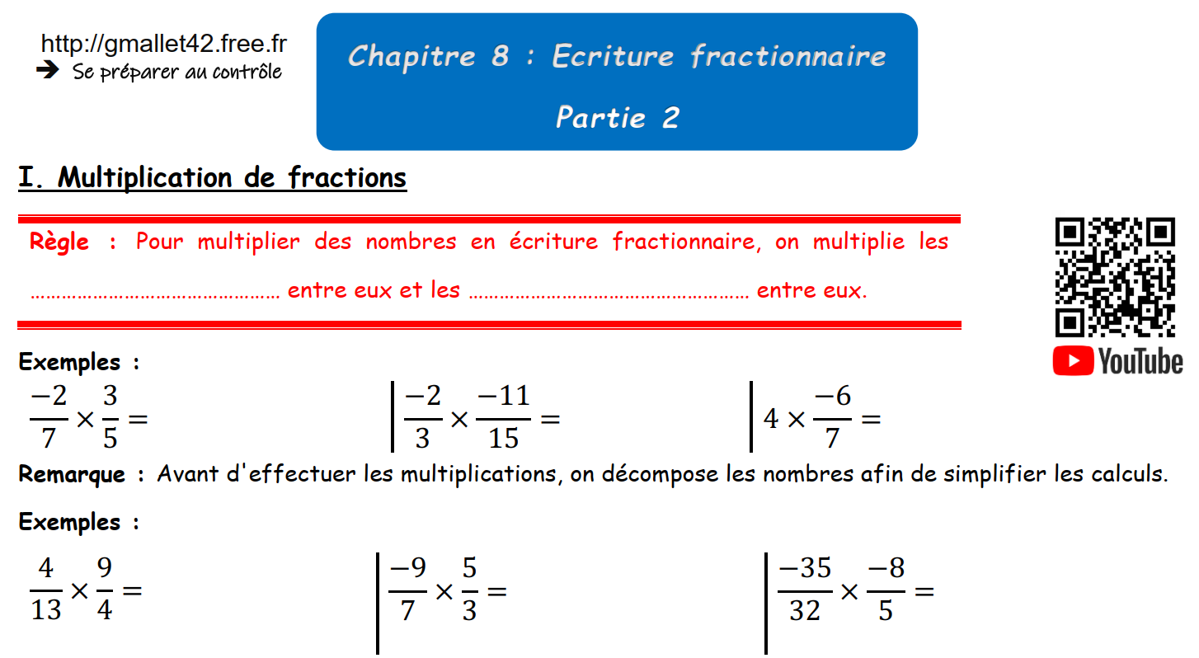

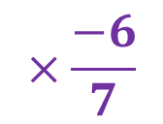
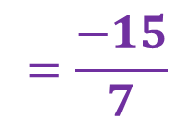
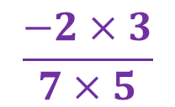

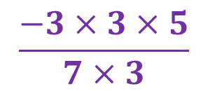
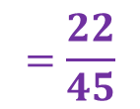
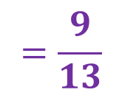
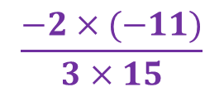
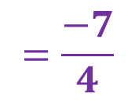
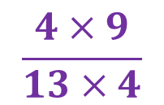
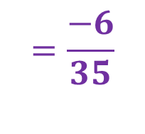
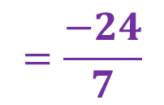
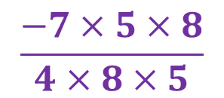
numérateurs
dénominateurs
$$\frac{−2×3}{7×5}$$
$$=\frac{−6}{35}$$
$$×\frac{−6}{7}$$
$$=\frac{−24}{7}$$
$$\frac{−2×(−11)}{3×15}$$
$$=\frac{22}{45}$$
$$\frac{4}{1}$$
$$\frac{4×9}{13×4}$$
$$=\frac{9}{13}$$
$$\frac{−3×3×5}{7×3}$$
$$=\frac{−15}{7}$$
$$\frac{−7×5×8}{4×8×5}$$
$$=\frac{−7}{4}$$

Slide 2
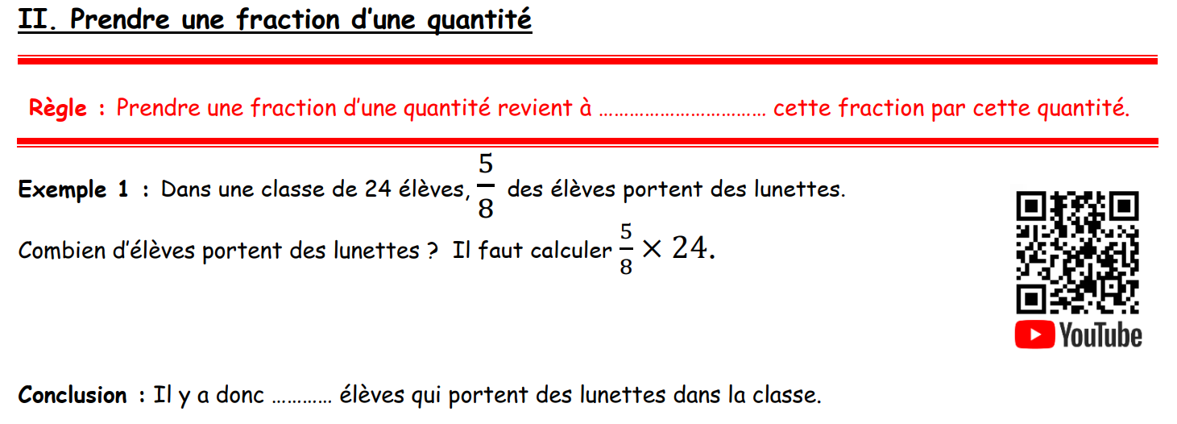
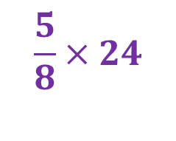

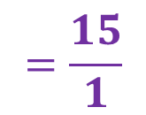
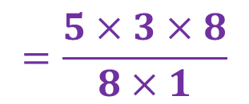
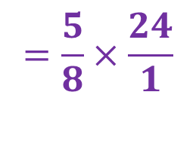
multiplier
$$\frac{5}{8}×24$$
$$=\frac{5}{8}×\frac{24}{1}$$
$$=\frac{5×3×8}{8×1}$$
$$=\frac{15}{1}$$
$$=15$$
15

Slide 3
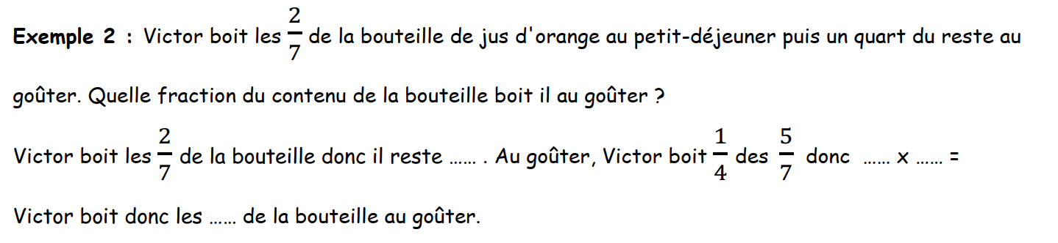

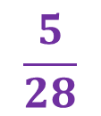
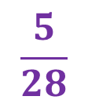


$$\frac{5}{7}$$
$$\frac{1}{4}$$
$$\frac{5}{7}$$
$$\frac{5}{28}$$
$$\frac{5}{28}$$

Slide 4
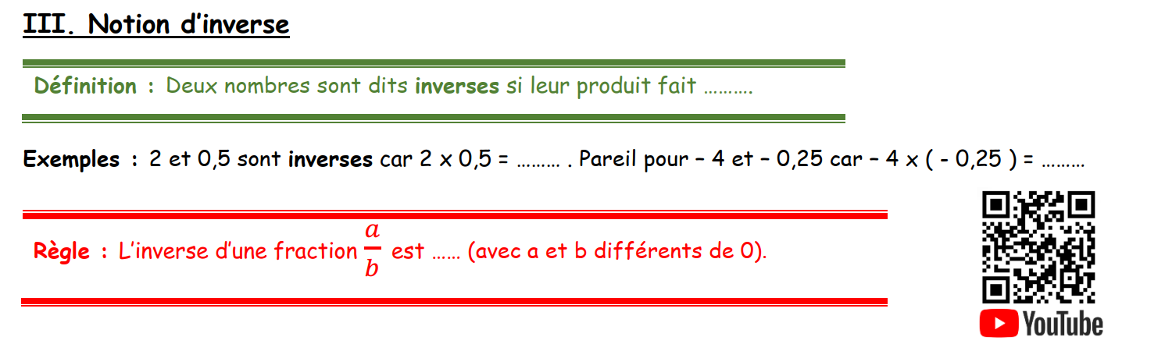
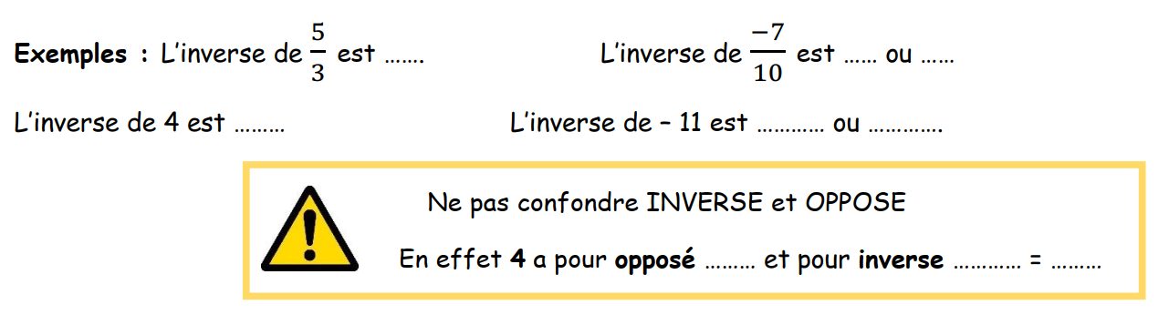
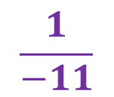

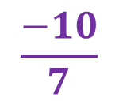

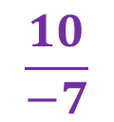


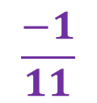


1
1
1
$$\frac{b}{a}$$
$$\frac{3}{5}$$
$$\frac{10}{−7}$$
$$\frac{−10}{7}$$
$$\frac{1}{4}$$
$$\frac{1}{−11}$$
$$\frac{−1}{11}$$
$$−4$$
$$\frac{1}{4}$$
$$0,25$$

Slide 5
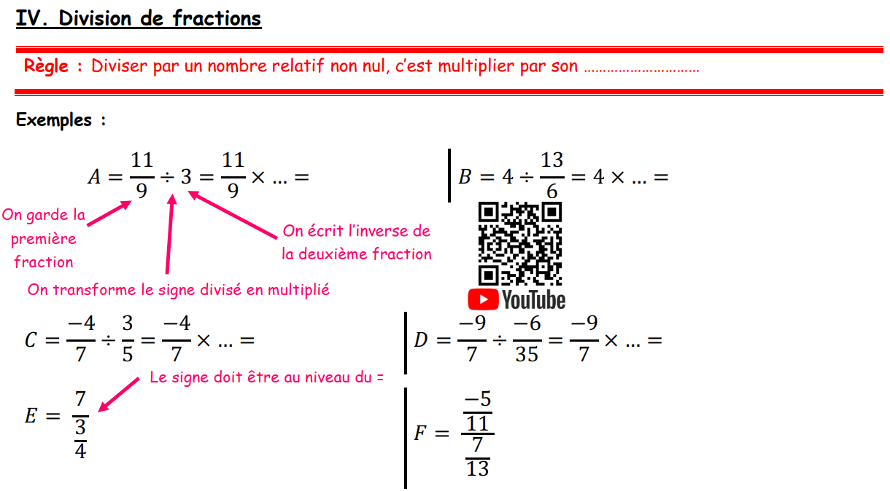

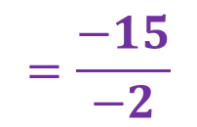
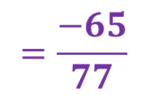

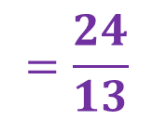
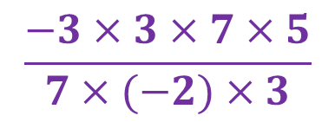
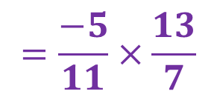
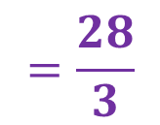
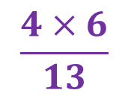
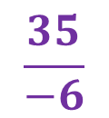
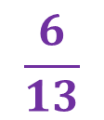
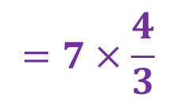
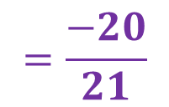
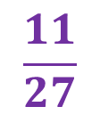
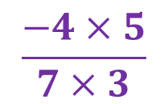
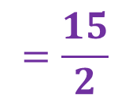
inverse
$$\frac{1}{3}$$
$$\frac{11}{27}$$
$$\frac{6}{13}$$
$$\frac{4×6}{13}$$
$$=\frac{24}{13}$$
$$\frac{5}{3}$$
$$\frac{−4×5}{7×3}$$
$$=\frac{−20}{21}$$
$$\frac{35}{−6}$$
$$\frac{−3×3×7×5}{7×(−2)×3}$$
$$=\frac{−15}{−2}$$
$$=\frac{15}{2}$$
$$=7×\frac{4}{3}$$
$$=\frac{28}{3}$$
$$=\frac{−5}{11}×\frac{13}{7}$$
$$=\frac{−65}{77}$$

Slide 6
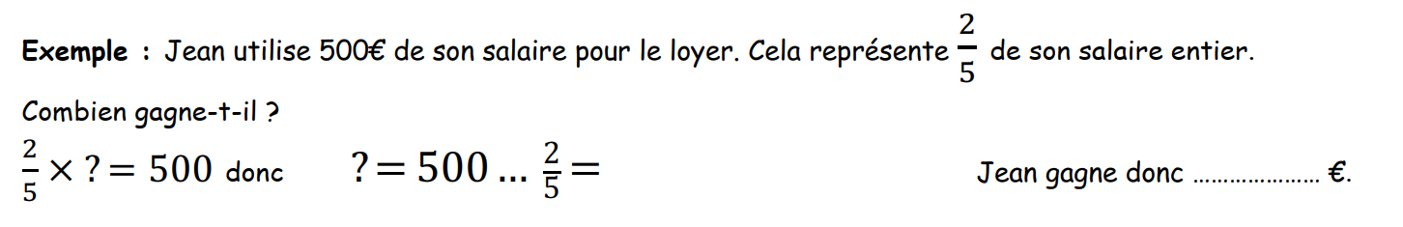


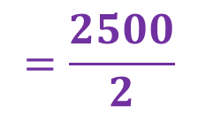
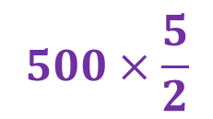
$$500×\frac{5}{2}$$
$$=\frac{2500}{2}$$
$$÷$$
1 250
$$=1 250$$

Slide 7
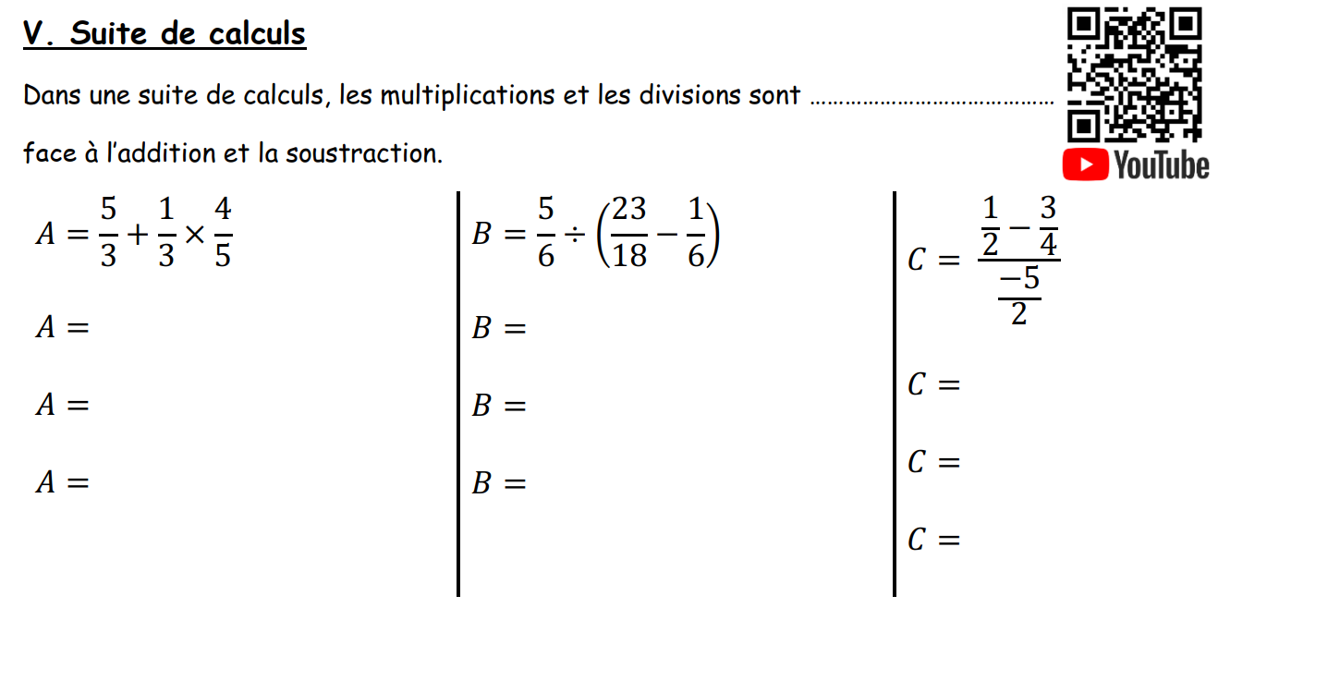
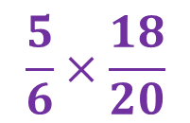
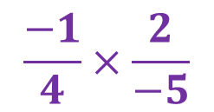
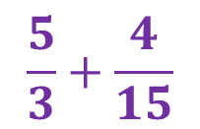
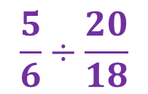









prioritaires
$$\frac{5}{3}+\frac{4}{15}$$
$$\frac{5}{6}÷\left(\frac{23}{18}−\frac{3}{18}\right)$$
$$\frac{\frac{2}{4}−\frac{3}{4}}{\frac{−5}{2}}$$
$$\frac{25}{15}+\frac{4}{15}$$
$$\frac{5}{6}÷\frac{20}{18}$$
$$\frac{\frac{−1}{4}}{\frac{−5}{2}}$$
$$\frac{29}{15}$$
$$\frac{5}{6}×\frac{18}{20}$$
$$\frac{−1}{4}×\frac{2}{−5}$$
$$B=\frac{5×6×3}{6×5×4}$$
$$C=\frac{−1×2}{2×2×(−5)}$$
$$=\frac{1}{10}$$
$$B=\frac{3}{4}$$

