Slide 1
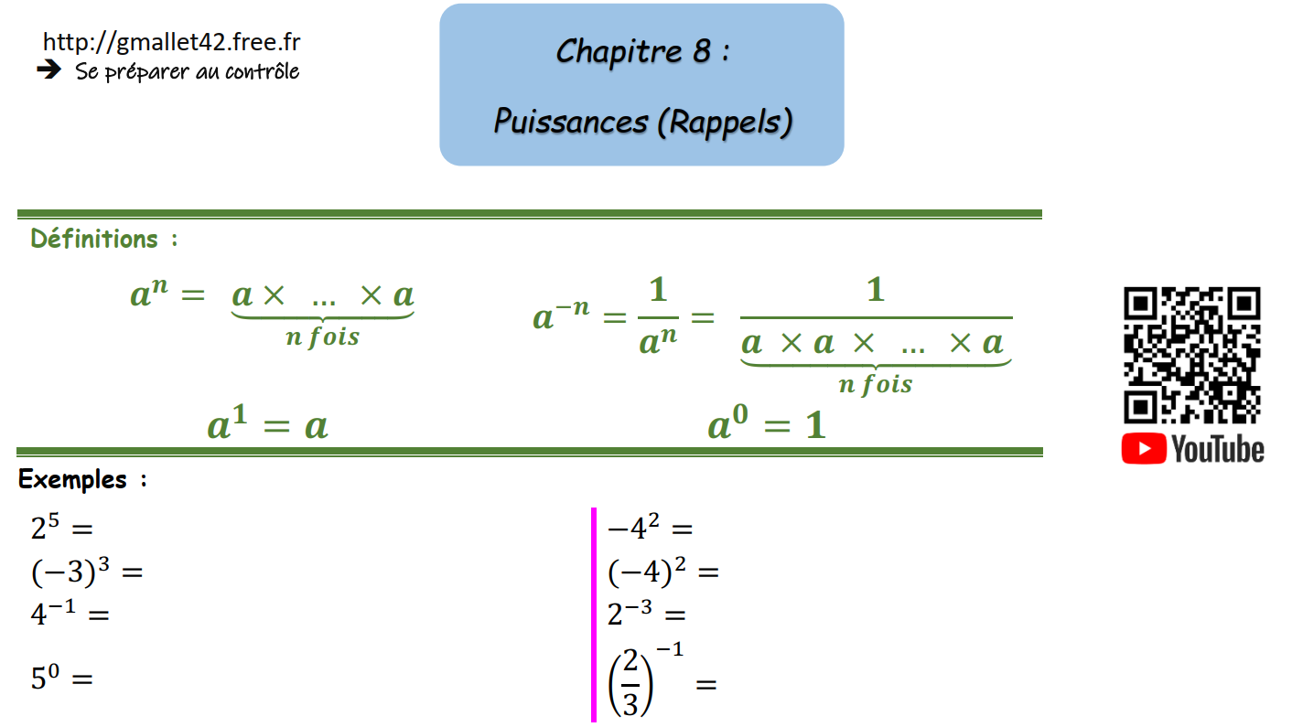





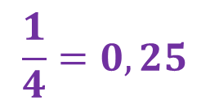
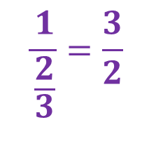

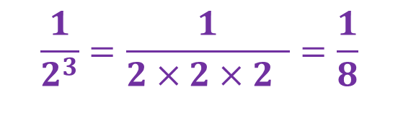
$$2 ×2 ×2 × 2 ×2 = 32$$
$$− 4×4=−16$$
$$\left(−3\right)×\left(−3\right)×\left(−3\right)=−27$$
$$\left(−4\right)×\left(−4\right)=16$$
$$\frac{1}{4}=0,25$$
$$\frac{1}{2^{3}}=\frac{1}{2×2×2 }=\frac{1}{8}$$
$$\frac{1}{\frac{2}{3}}=\frac{3}{2}$$
$$1$$

Slide 2
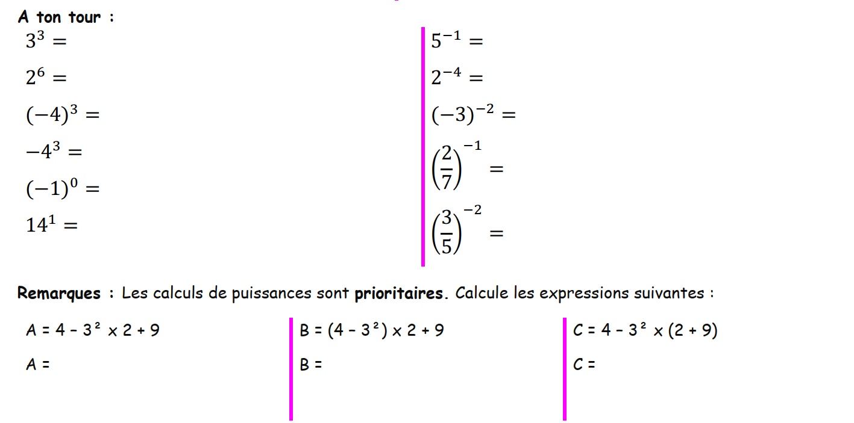

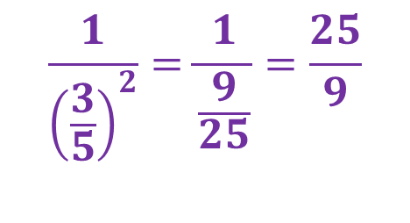




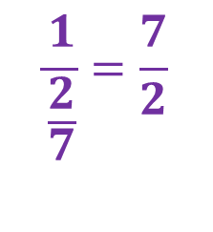




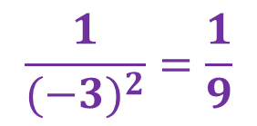



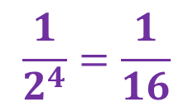


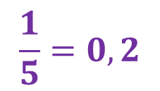


$$\frac{1}{5}=0,2$$
$$3 ×3 ×3 =27$$
$$\frac{1}{2^{4}}=\frac{1}{16}$$
$$2 ×2 ×2 × 2 ×2×2 =64$$
$$\frac{1}{{(−3)}^{2}}=\frac{1}{9}$$
$$\left(−4\right)×\left(−4\right)×\left(−4\right)=−64$$
$$−4×4×4 =−64$$
$$\frac{1}{\frac{2}{7}}=\frac{7}{2}$$
$$1$$
$$14$$
$$\frac{1}{{\left(\frac{3}{5}\right)}^{2}}=\frac{1}{\frac{9}{25}}=\frac{25}{9}$$
$$4−9×2+9$$
$$(4−9)×2+9$$
$$4−9×11$$
$$A=4−18+9$$
$$B=−5×2+9$$
$$C=4−99$$
$$B=−10+9$$
$$A=−5$$
$$C=−95$$
$$B=−1$$

Slide 3
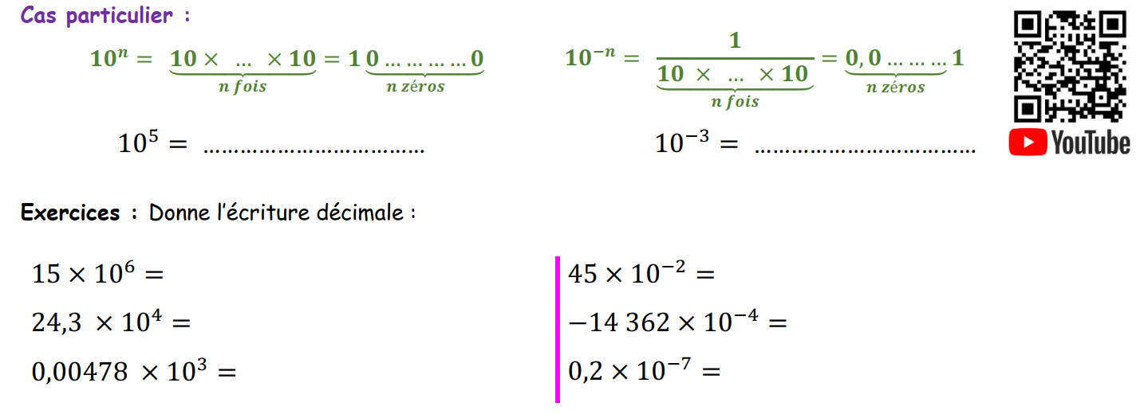

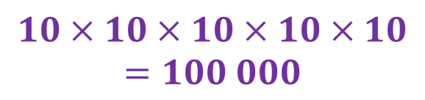




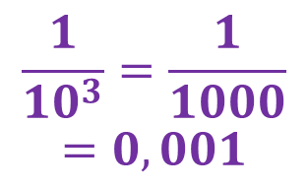

$$10×10×10×10×10$$
$$=100 000$$
$$\frac{1}{{10}^{3}}=\frac{1}{1000}$$
$$=0,001$$
$$15 000 000$$
$$0,45$$
$$243 000$$
$$−1,4362$$
$$4,78$$
$$0,00000002$$

Slide 4
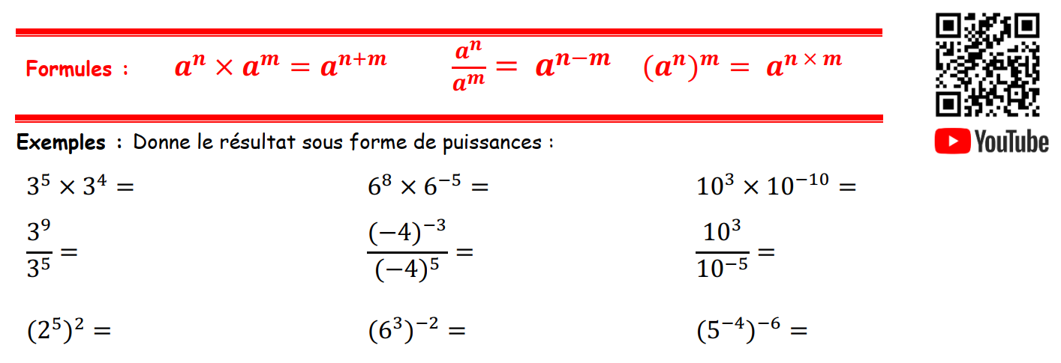


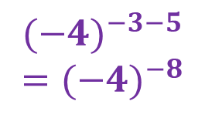






$$3^{5+4}=3^{9}$$
$$6^{8+(−5)}=6^{3}$$
$${10}^{3+(−10)}={10}^{−7}$$
$$3^{9−5}=3^{4}$$
$${(−4)}^{−3−5}$$
$$={(−4)}^{−8}$$
$${10}^{3−(−5)}={10}^{8}$$
$$2^{5×2}=2^{10}$$
$$6^{3×(−2)}=6^{−6}$$
$$5^{(−4)×(−6)}=5^{24}$$

Slide 5
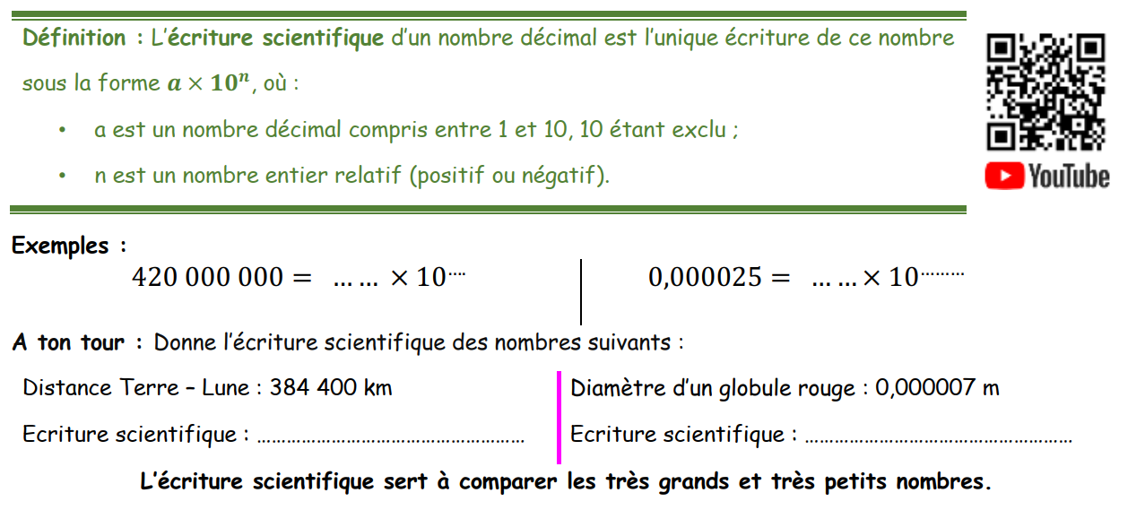






$$4,2$$
$$8$$
$$2,5$$
$$−5$$
$$3,844×{10}^{5}$$
$$7×{10}^{−6}$$

Slide 6
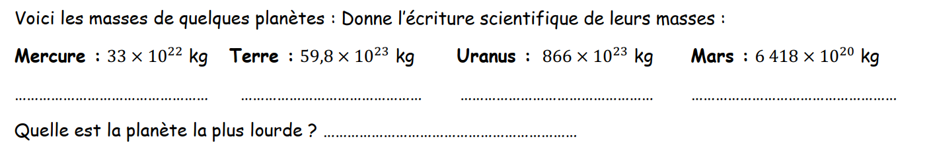




$$3,3×{10}^{23}$$
$$5,98×{10}^{24}$$
$$8,66×{10}^{25}$$
$$6,418×{10}^{23}$$
C’est Uranus.

Slide 7
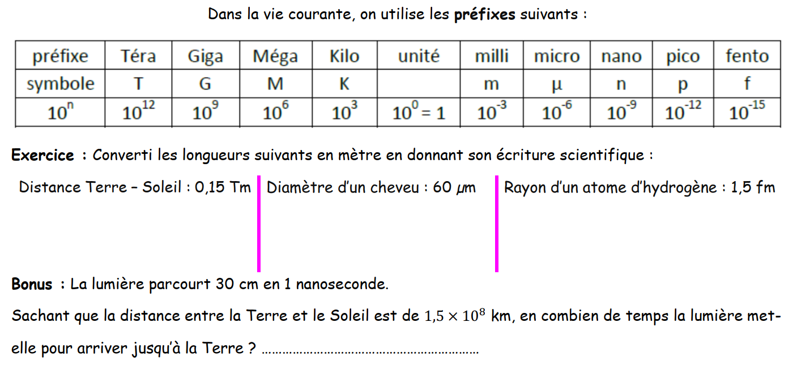





$$0,15×{10}^{12}$$
$$60×{10}^{−6}$$
$$1,5×{10}^{−15}$$
$$=1,5×{10}^{11}$$
$$=6×{10}^{−5}$$

